Slide 1
Using OrthoFinder to identify shared orthologs
How can we computationally determine what coding sequences are shared between organisms

Slide 2
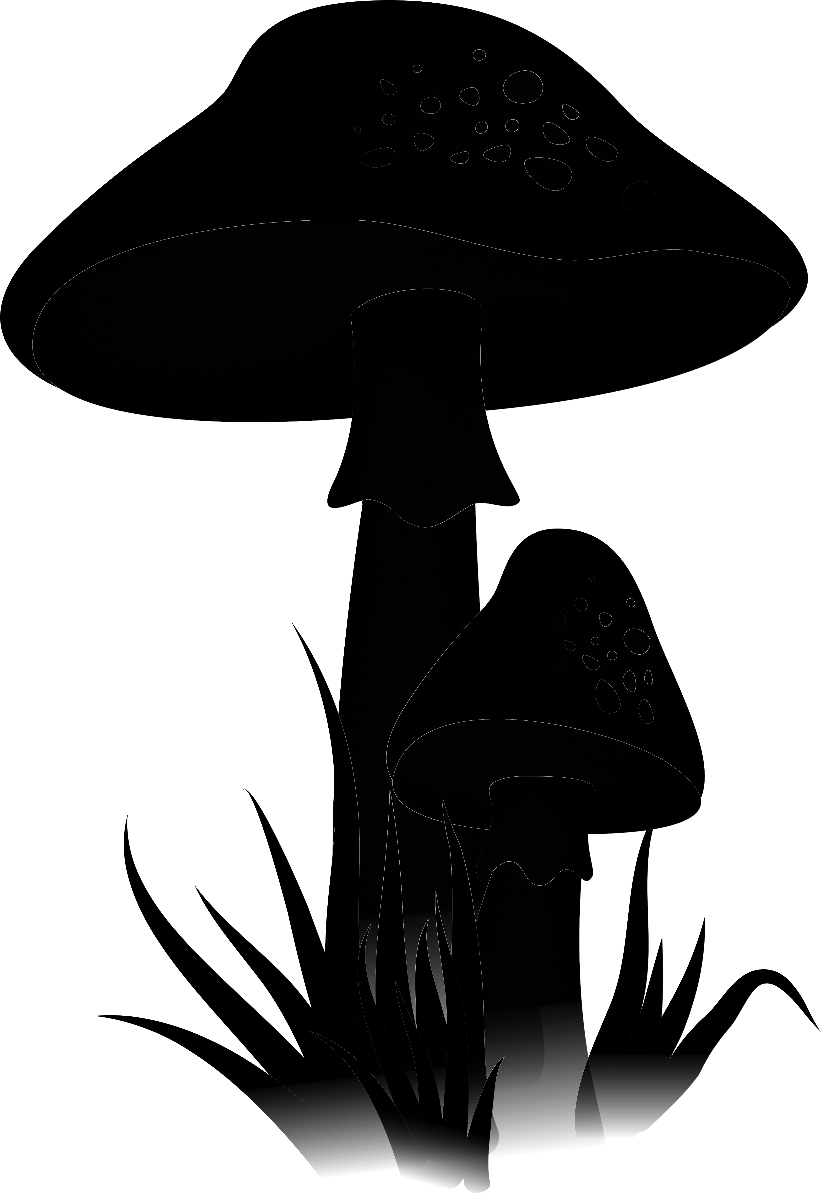
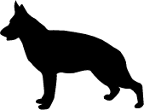
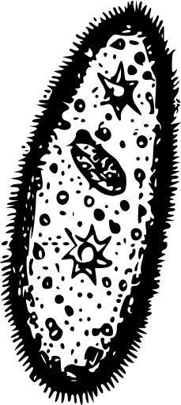
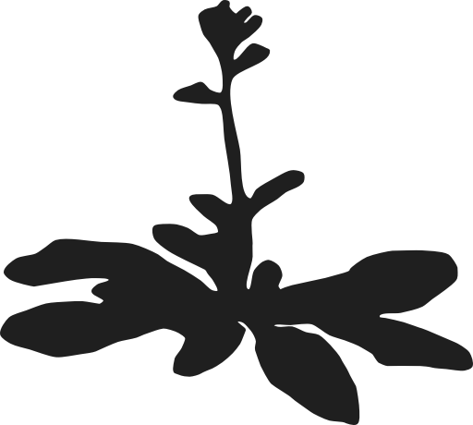
Homology and common ancestry
Canis lupus
Amanita muscaria
Arabidopsis thaliana
Paramecium spp.

Slide 3
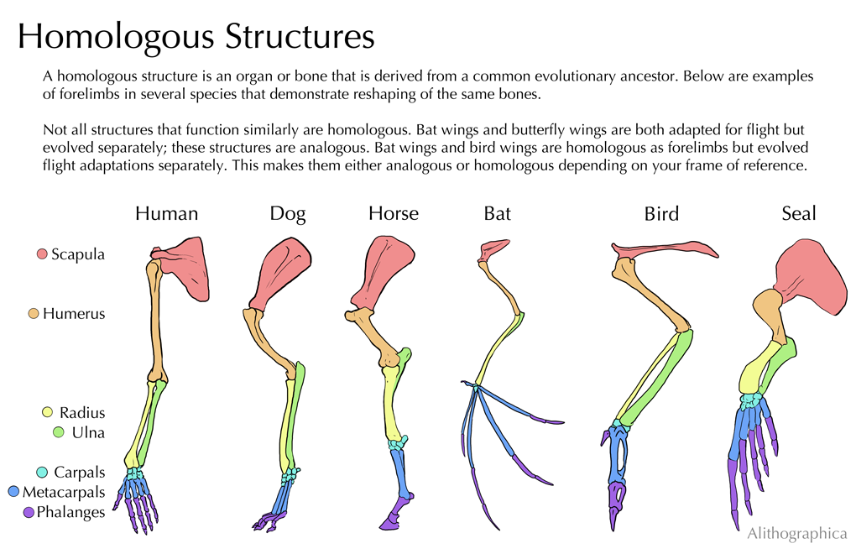
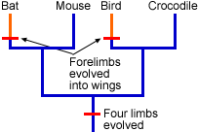
Homology
Characters in different organisms that are similar because they were inherited from a common ancestor that also had that character
University of California Museum of Paleontology

Slide 4
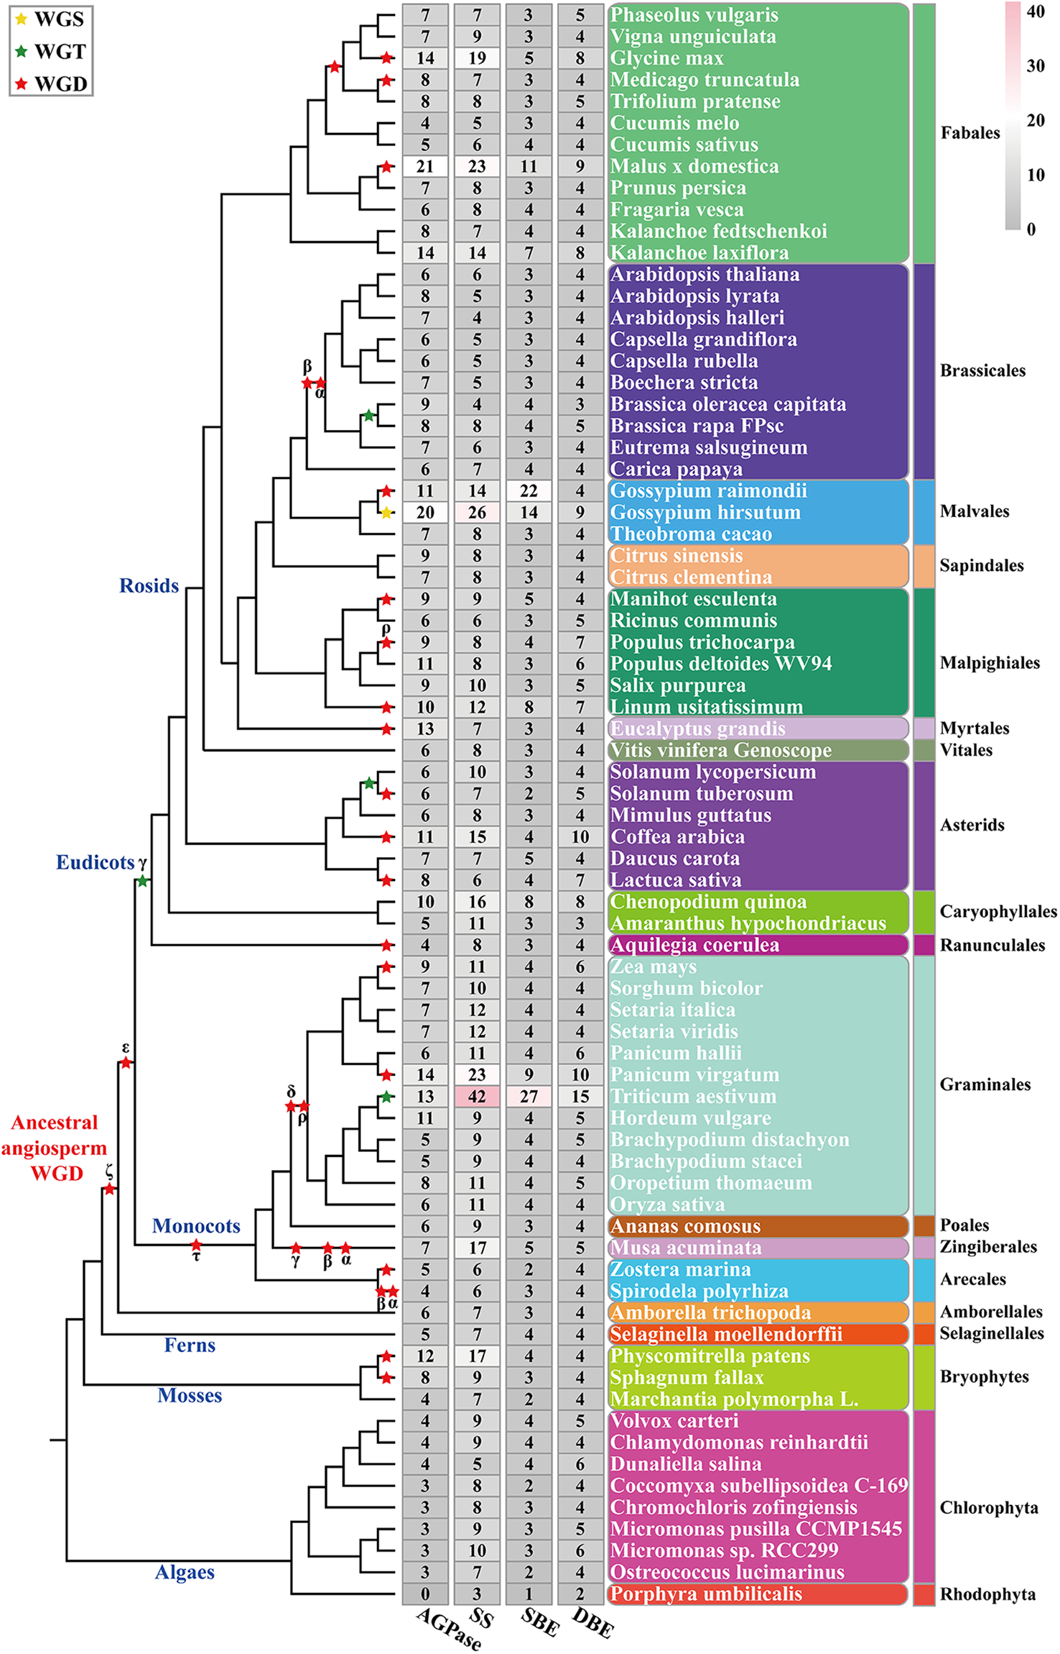
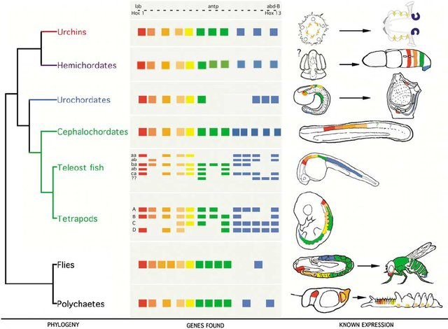
Homology
Genes in different organisms that are similar because they were inherited from a common ancestor that also had that character
HOX genes in Animalia
Starch synthesis genes in plantae
Swalla (2006)
Qu, et al (2018)

Slide 5
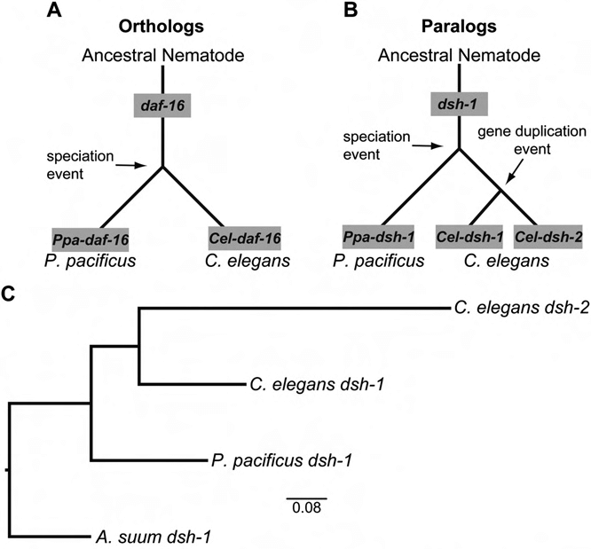
Homology in molecular data
Orthologs:
Homologous genes derived by speciation events (Common ancestry)
Paralogs:
Homologous genes expanded within a species
(Genic duplication)
Dilman et al. (2012). Incorporating Genomics into the Toolkit of Nematology (Catie Wram: read this).

Slide 6
Homology in molecular data
HOX genes in Metazoa
HOX genes are essential for body plan/segmentation
Maintained across metazoan species and diverged by speciation
Swalla (2006)

Slide 7
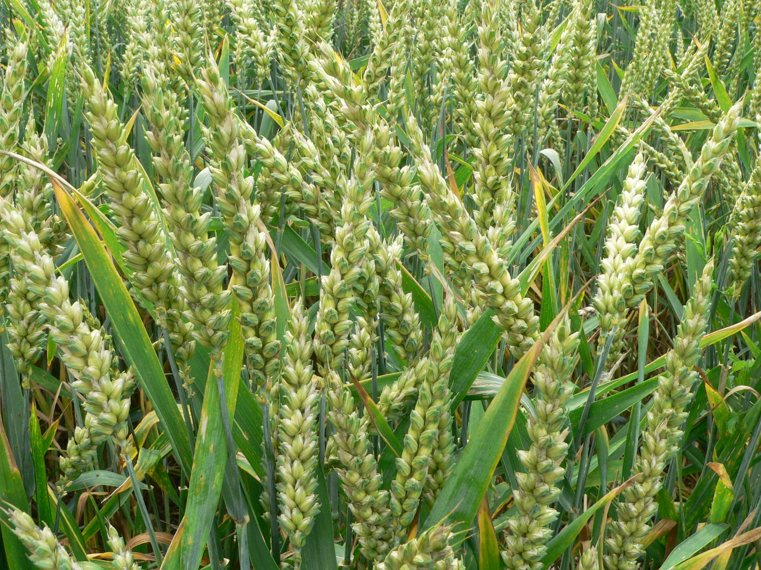
Starch synthesis genes in Viridiplantae
Genic expansions
Whole genome duplications
Starch is one of the most important traits for wheat breeding and production

Slide 8
How to identify orthologous/paralogous genes?
Canis lupus
Amanita muscaria
Arabidopsis thaliana
Paramecium spp.

Slide 9
Canis lupus
Amanita muscaria
Arabidopsis thaliana
Paramecium spp.

Slide 10
Paralogy?
Canis lupus
Amanita muscaria
Orthology?
Arabidopsis thaliana
Paramecium spp.

Slide 11
Identifying orthology using sequence data
Ortholog group is the set of genes that are descended from a single gene in the last common ancestor of all the species being considered
Ortholog group 1
Paralogs
Canis lupus
Ortholog group 2
Arabidopsis thaliana
Amanita muscaria
Unique genes
Paramecium spp.

Slide 12
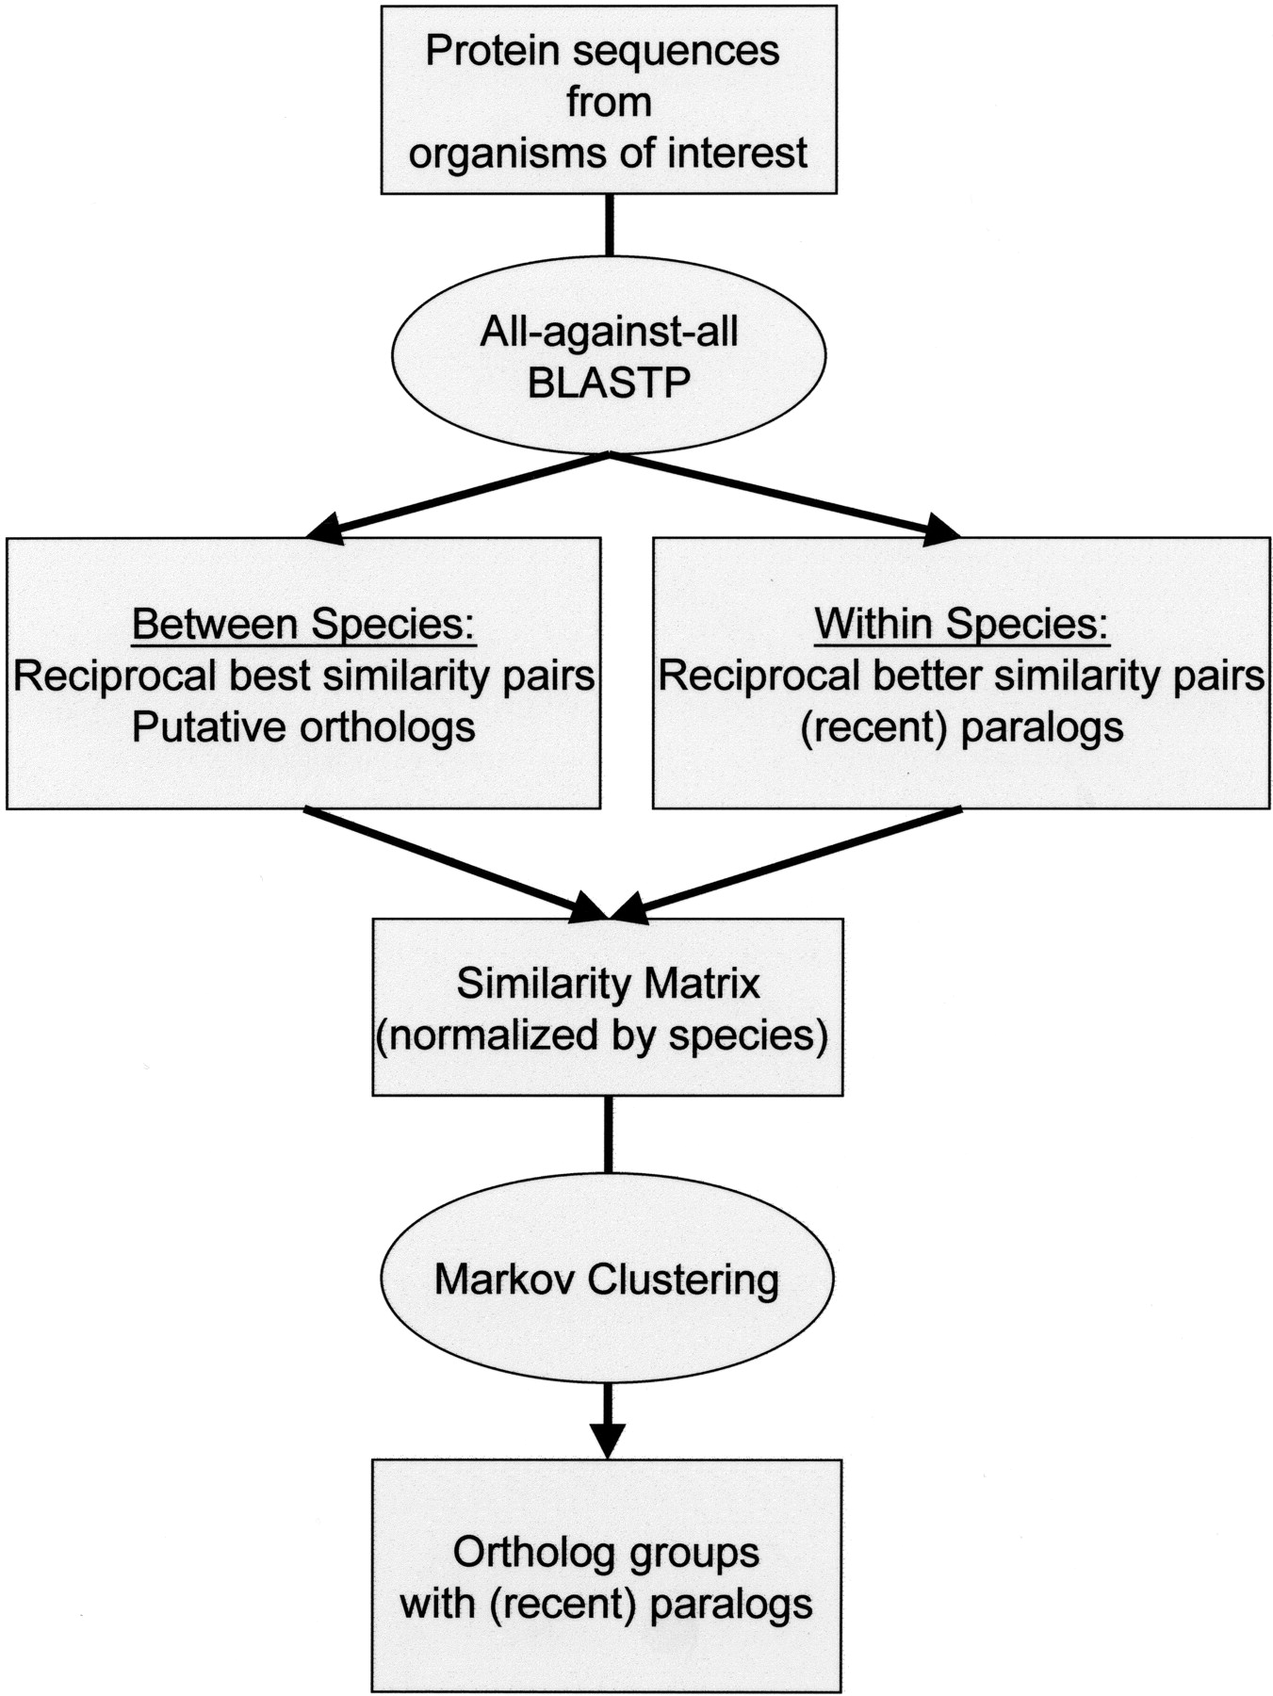
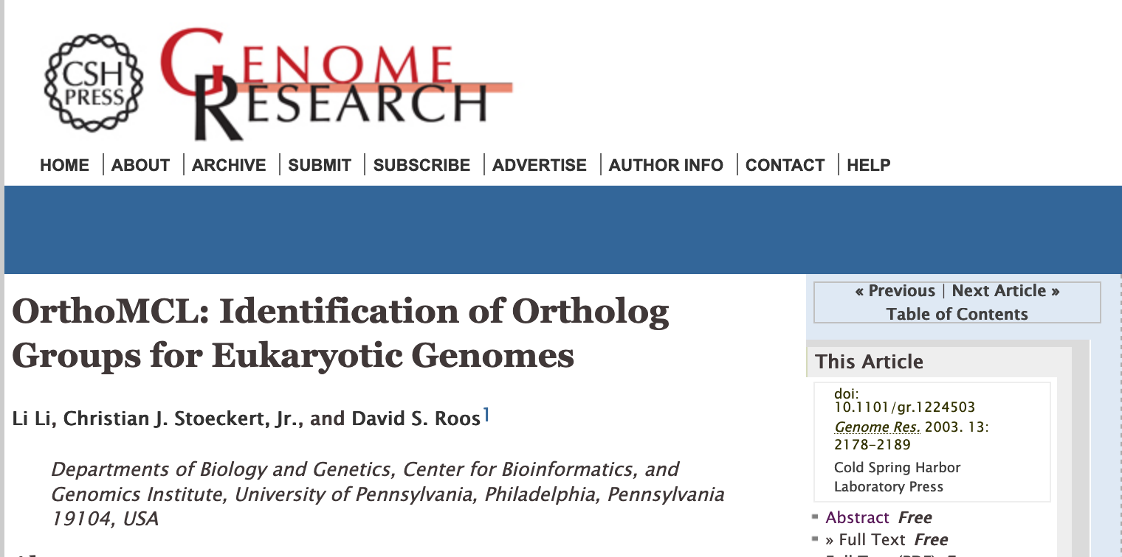
Identifying orthology using sequence data

Slide 13
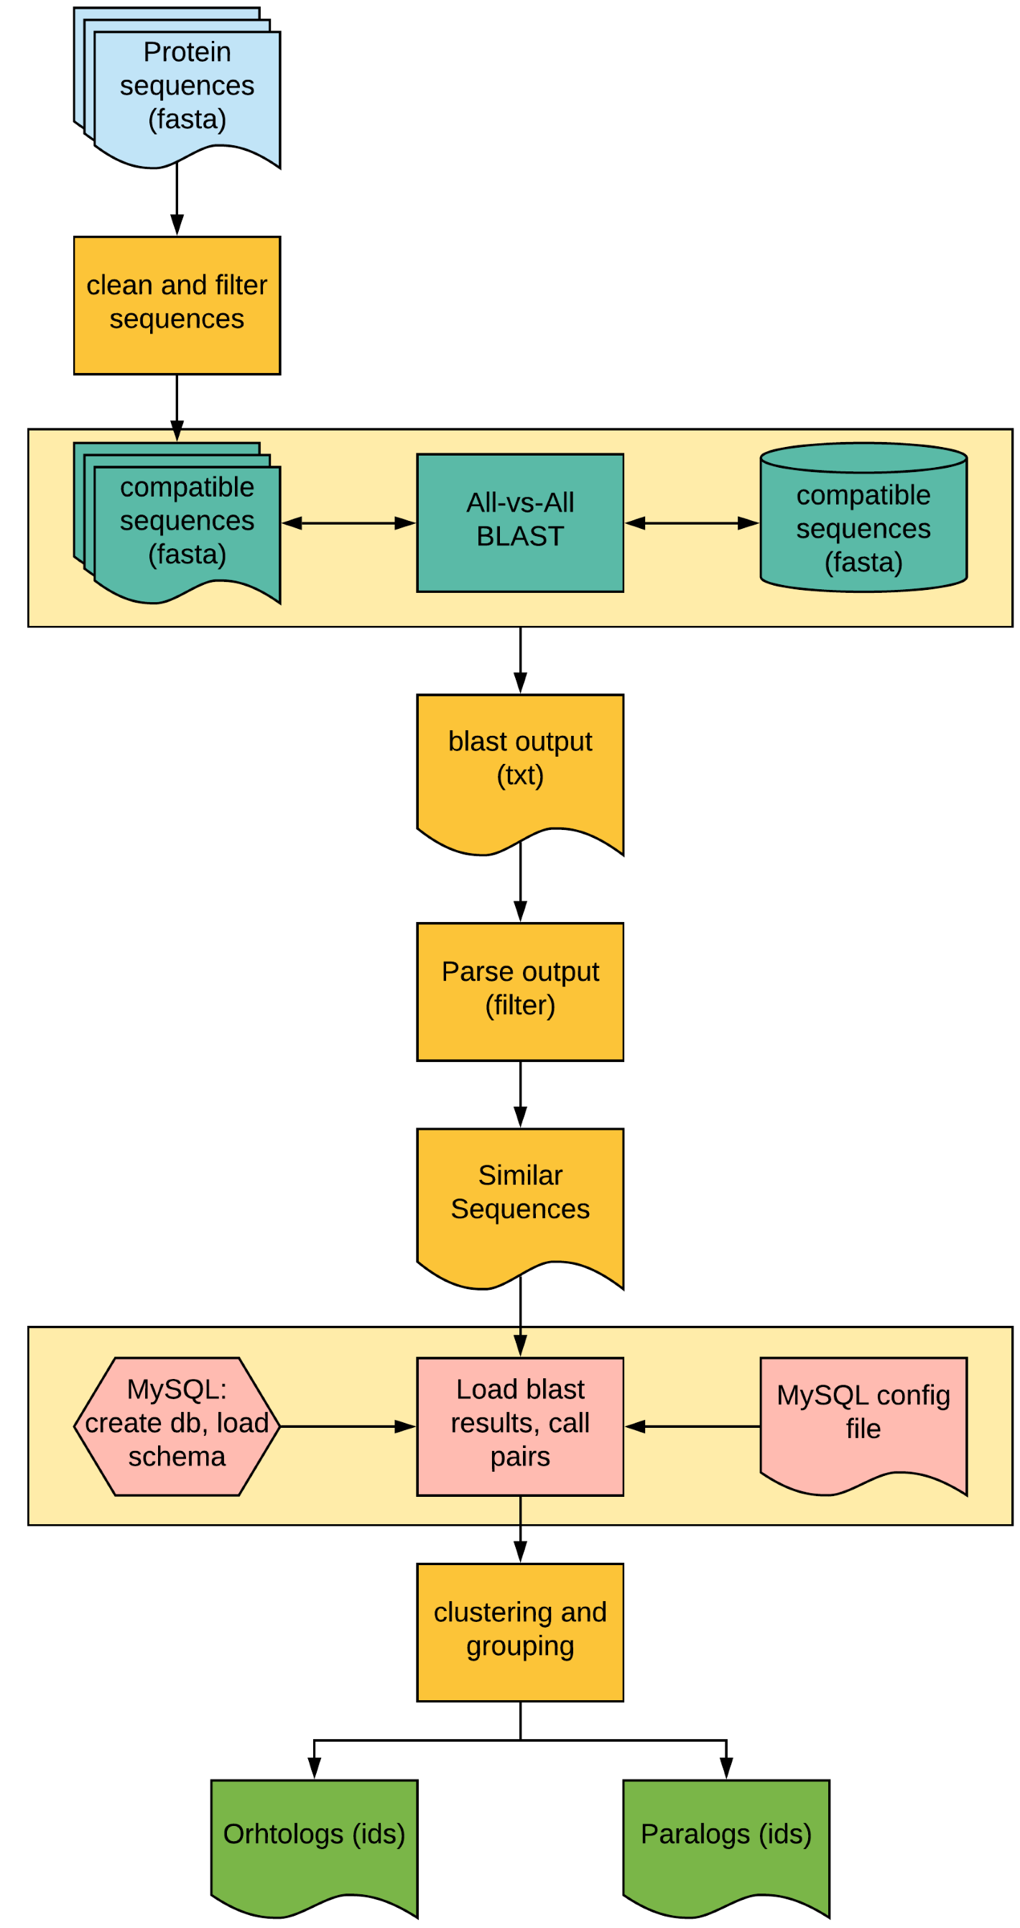
Identifying orthology using sequence data
Sequence ID
Parsing steps
DB creation step
Clustering
No downstream analyses

Slide 14
Identifying orthology using sequence data
Sequence ID
Parsing steps
DB creation step
Clustering
No downstream analyses

Slide 15
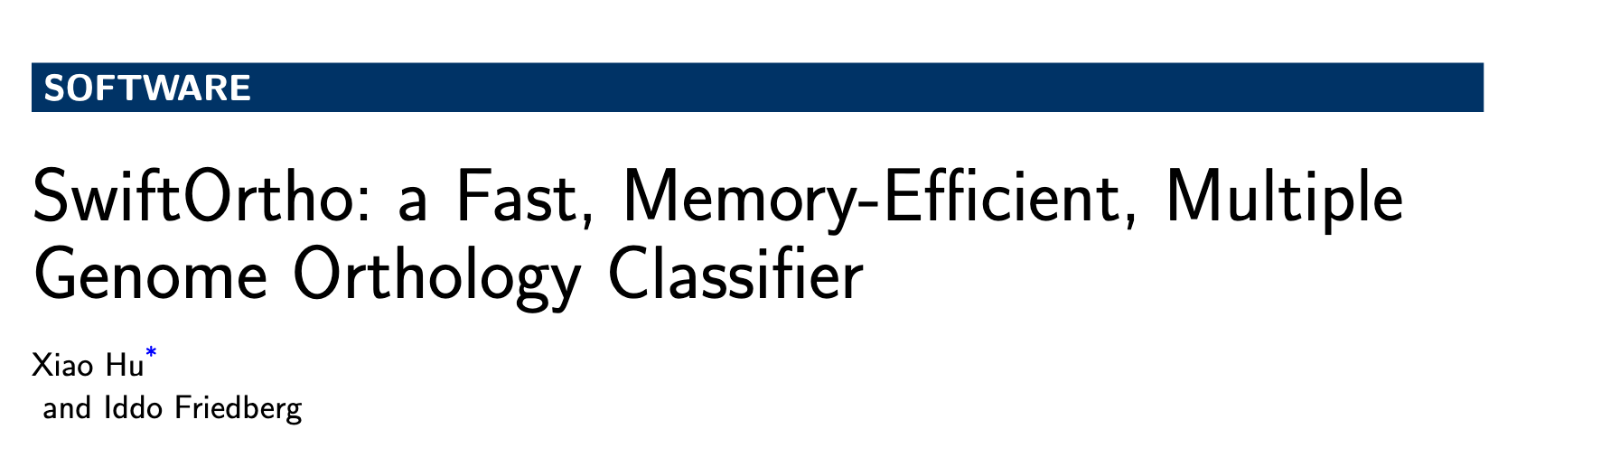
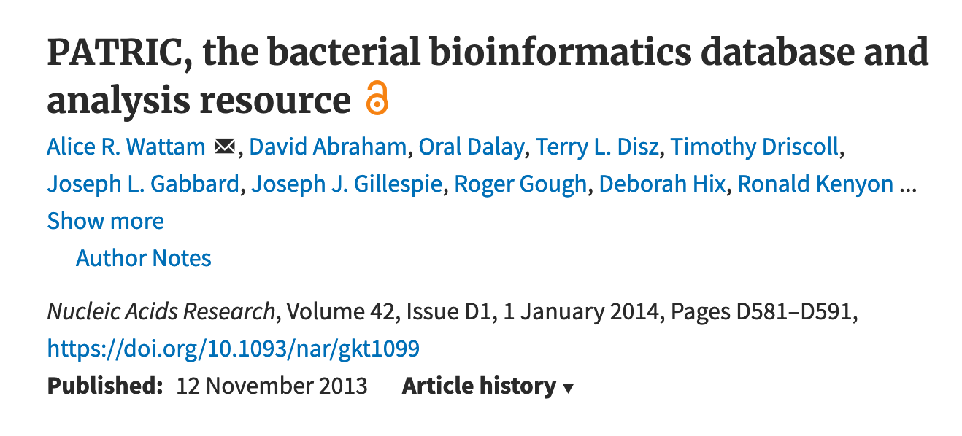
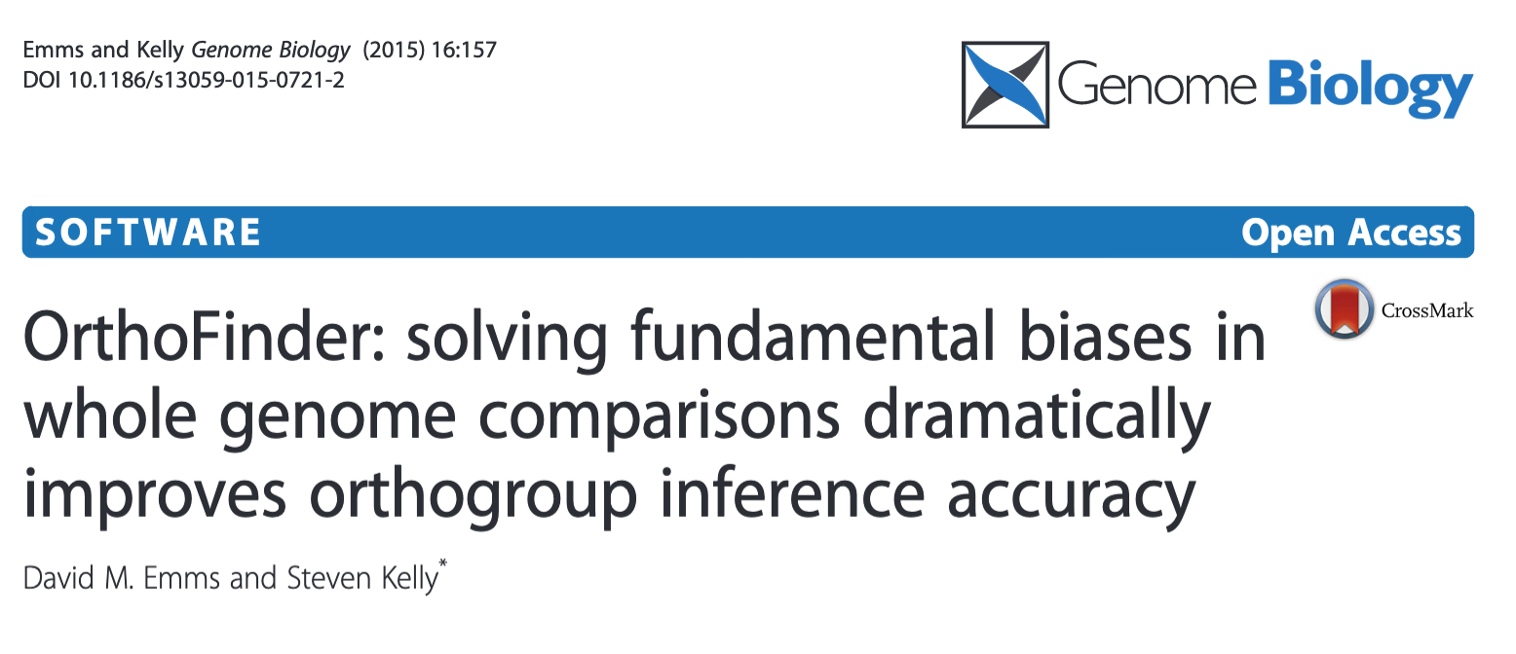
Identifying orthology using sequence data
FastOrtho

Slide 16
Identifying orthology using sequence data
Short sequences cannot produce large bit scores or low e-values.
Long sequences produce many hits with scores better than those for the best hits of short sequences.
Methods based on BLAST scores in the absence of gene length information result in a large number of missing genes from orthogroups that contain short genes and a large number of incorrectly clustered genes.

Slide 17
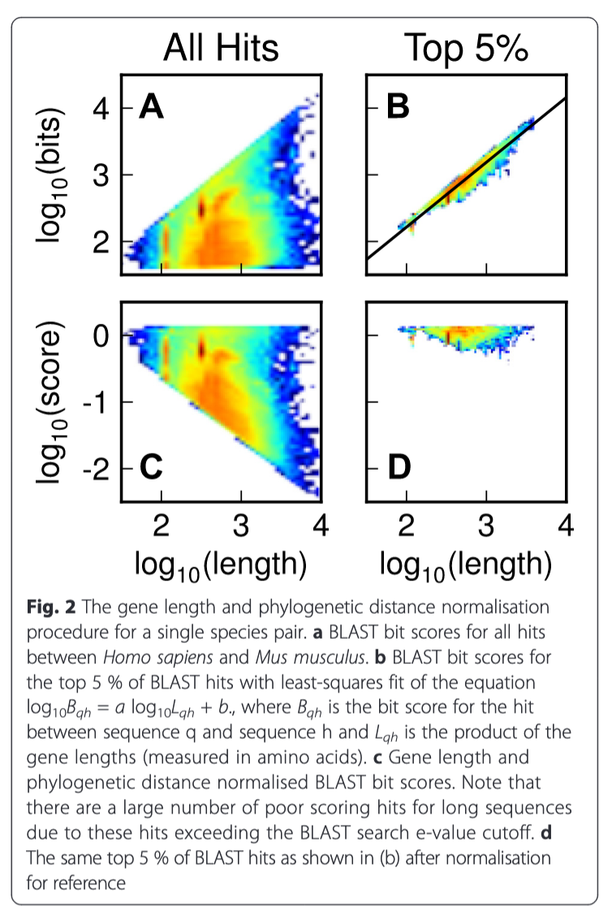
OrthoFinder
Short sequences cannot produce large bit scores or low e-values.
Long sequences produce many hits with scores better than those for the best hits of short sequences.
Methods based on BLAST scores in the absence of gene length information result in a large number of missing genes from orthogroups that contain short genes and a large number of incorrectly clustered genes.
Notes:
RBNHs (Reciprocal Best length-Normalised hit) to define the lower limit ofs equence similarity for putative cognate genes of each query gene.
To be included in the orthogroupgraph a gene-pair must be an RBNH or produce a hit that is better scoring than the lowest scoring RBNH (irrespective of species) for either gene. (4) (PDF) OrthoFinder: solving fundamental biases in whole genome comparisons dramatically improves orthogroup inference accuracy. Available from: https://www.researchgate.net/publication/280836999_OrthoFinder_solving_fundamental_biases_in_whole_genome_comparisons_dramatically_improves_orthogroup_inference_accuracy [accessed Feb 09 2020].

Slide 18
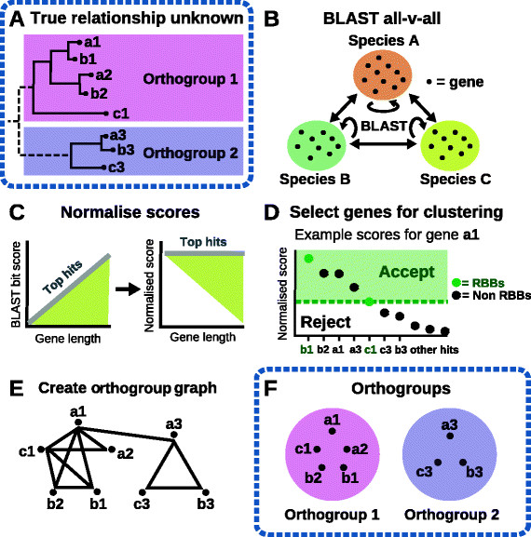
OrthoFinder
Sequence ID
Score normalization
Clustering
Notes:
RBNHs (Reciprocal Best length-Normalised hit) to define the lower limit ofs equence similarity for putative cognate genes of each query gene.
To be included in the orthogroupgraph a gene-pair must be an RBNH or produce a hit that is better scoring than the lowest scoring RBNH (irrespective of species) for either gene. (4) (PDF) OrthoFinder: solving fundamental biases in whole genome comparisons dramatically improves orthogroup inference accuracy. Available from: https://www.researchgate.net/publication/280836999_OrthoFinder_solving_fundamental_biases_in_whole_genome_comparisons_dramatically_improves_orthogroup_inference_accuracy [accessed Feb 09 2020].

Slide 19
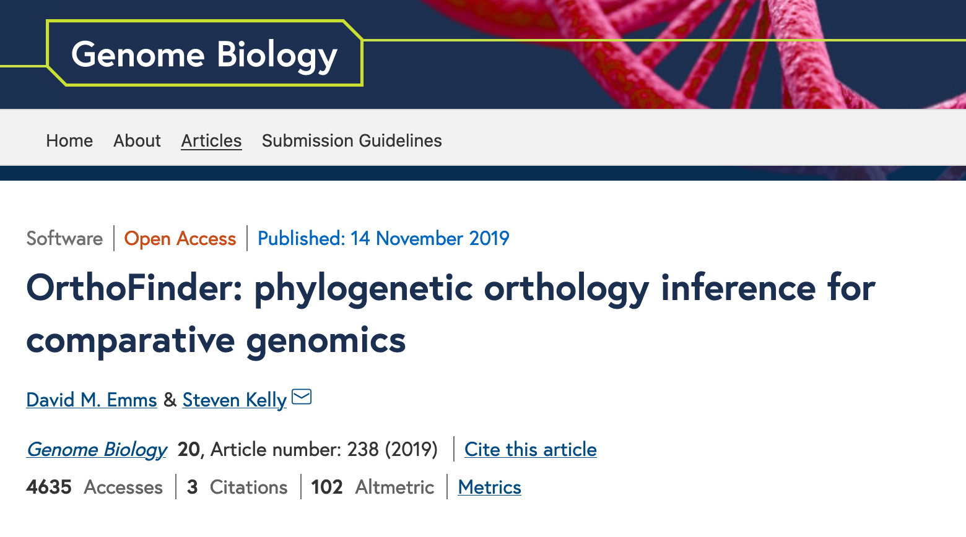
OrthoFinder 2
Notes:
RBNHs (Reciprocal Best length-Normalised hit) to define the lower limit ofs equence similarity for putative cognate genes of each query gene.
To be included in the orthogroupgraph a gene-pair must be an RBNH or produce a hit that is better scoring than the lowest scoring RBNH (irrespective of species) for either gene. (4) (PDF) OrthoFinder: solving fundamental biases in whole genome comparisons dramatically improves orthogroup inference accuracy. Available from: https://www.researchgate.net/publication/280836999_OrthoFinder_solving_fundamental_biases_in_whole_genome_comparisons_dramatically_improves_orthogroup_inference_accuracy [accessed Feb 09 2020].

Slide 20
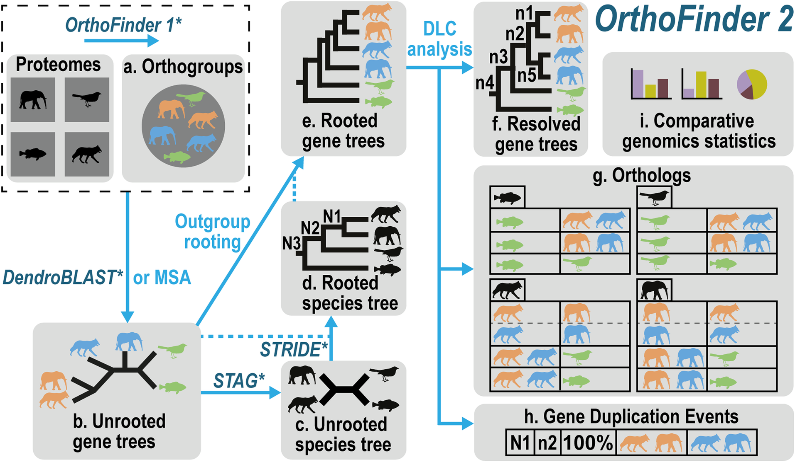
OrthoFinder 2
Notes:
RBNHs (Reciprocal Best length-Normalised hit) to define the lower limit ofs equence similarity for putative cognate genes of each query gene.
To be included in the orthogroupgraph a gene-pair must be an RBNH or produce a hit that is better scoring than the lowest scoring RBNH (irrespective of species) for either gene. (4) (PDF) OrthoFinder: solving fundamental biases in whole genome comparisons dramatically improves orthogroup inference accuracy. Available from: https://www.researchgate.net/publication/280836999_OrthoFinder_solving_fundamental_biases_in_whole_genome_comparisons_dramatically_improves_orthogroup_inference_accuracy [accessed Feb 09 2020].

Slide 21
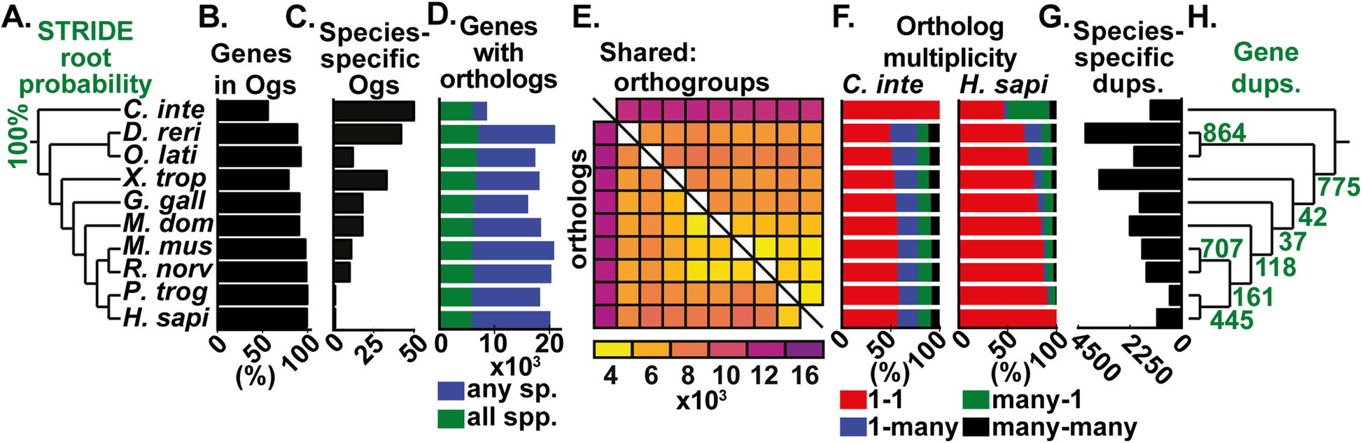
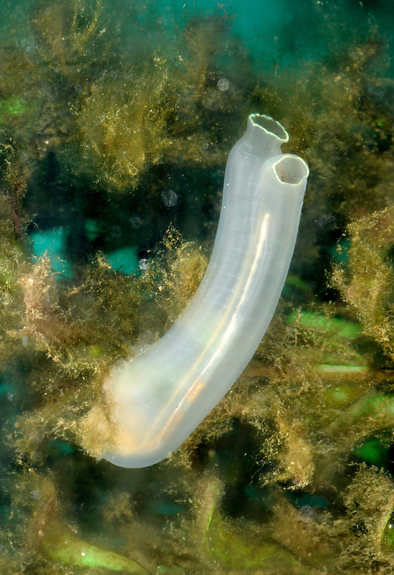
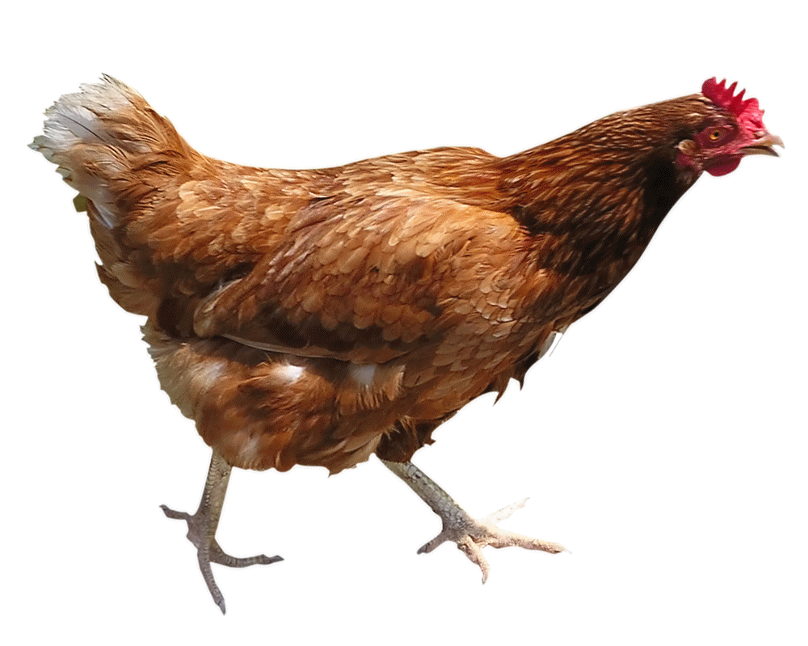
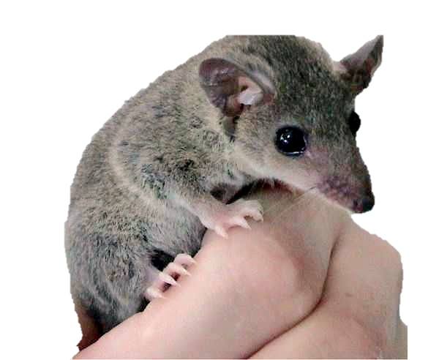
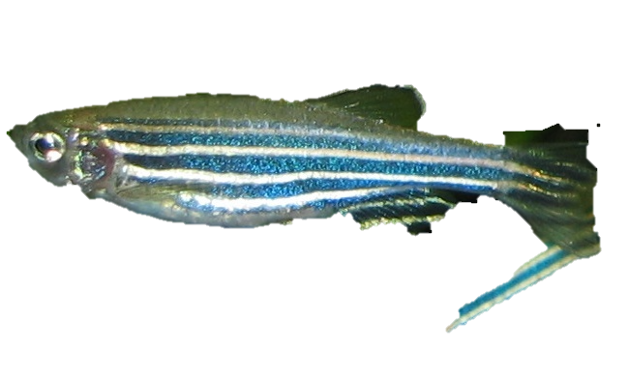
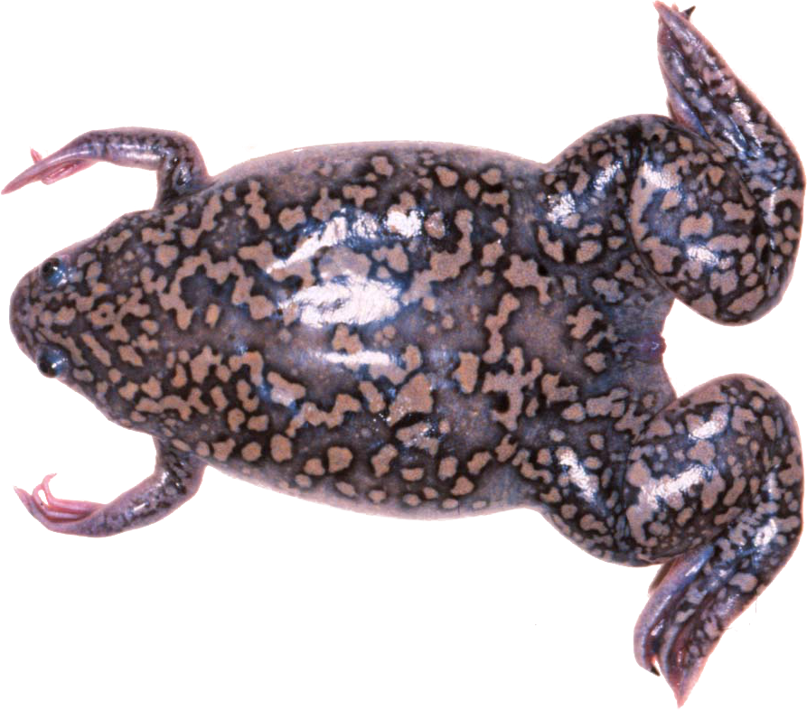
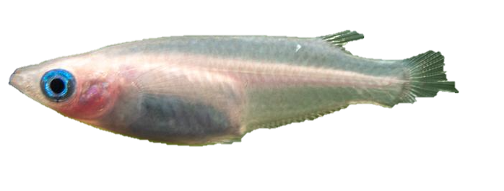
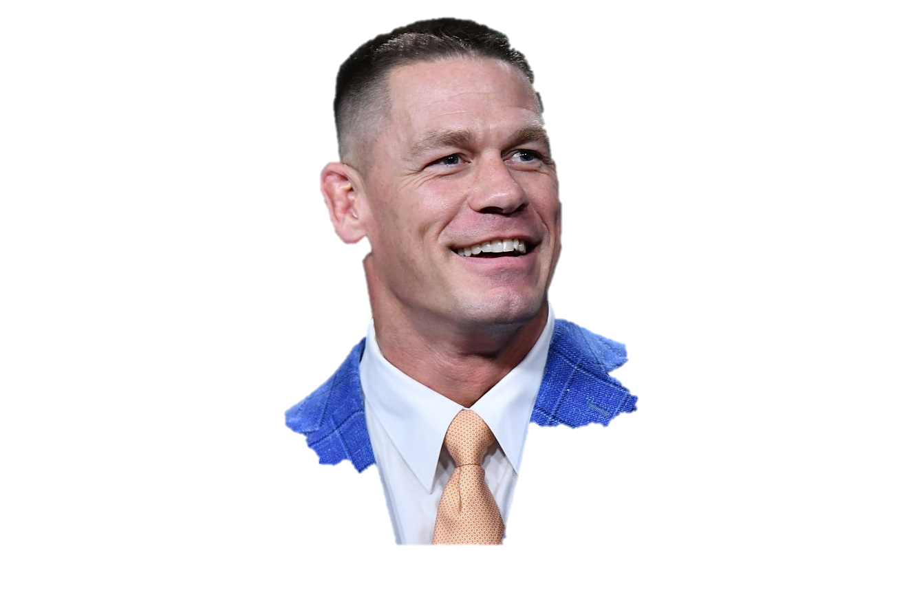
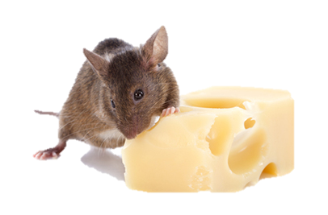
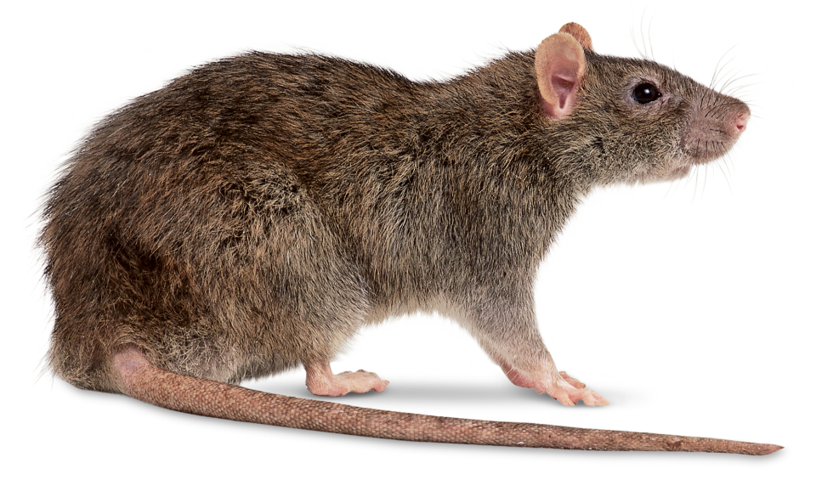
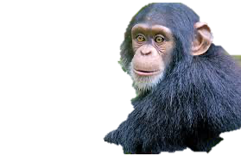
Ciona intestinalis, Danio rerio, Oryzias latipes, Xenopus tropicalis, Gallus gallus, Monodelphis domestica, Mus musculus, Rattus norvegicus, Pan troglodytes, and Homo sapiens.
Notes:
RBNHs (Reciprocal Best length-Normalised hit) to define the lower limit ofs equence similarity for putative cognate genes of each query gene.
To be included in the orthogroupgraph a gene-pair must be an RBNH or produce a hit that is better scoring than the lowest scoring RBNH (irrespective of species) for either gene. (4) (PDF) OrthoFinder: solving fundamental biases in whole genome comparisons dramatically improves orthogroup inference accuracy. Available from: https://www.researchgate.net/publication/280836999_OrthoFinder_solving_fundamental_biases_in_whole_genome_comparisons_dramatically_improves_orthogroup_inference_accuracy [accessed Feb 09 2020].

Slide 22
OrthoFinder 2
Canis lupus
Amanita muscaria
Arabidopsis thaliana
Paramecium spp.
Notes:
RBNHs (Reciprocal Best length-Normalised hit) to define the lower limit ofs equence similarity for putative cognate genes of each query gene.
To be included in the orthogroupgraph a gene-pair must be an RBNH or produce a hit that is better scoring than the lowest scoring RBNH (irrespective of species) for either gene. (4) (PDF) OrthoFinder: solving fundamental biases in whole genome comparisons dramatically improves orthogroup inference accuracy. Available from: https://www.researchgate.net/publication/280836999_OrthoFinder_solving_fundamental_biases_in_whole_genome_comparisons_dramatically_improves_orthogroup_inference_accuracy [accessed Feb 09 2020].

Slide 23
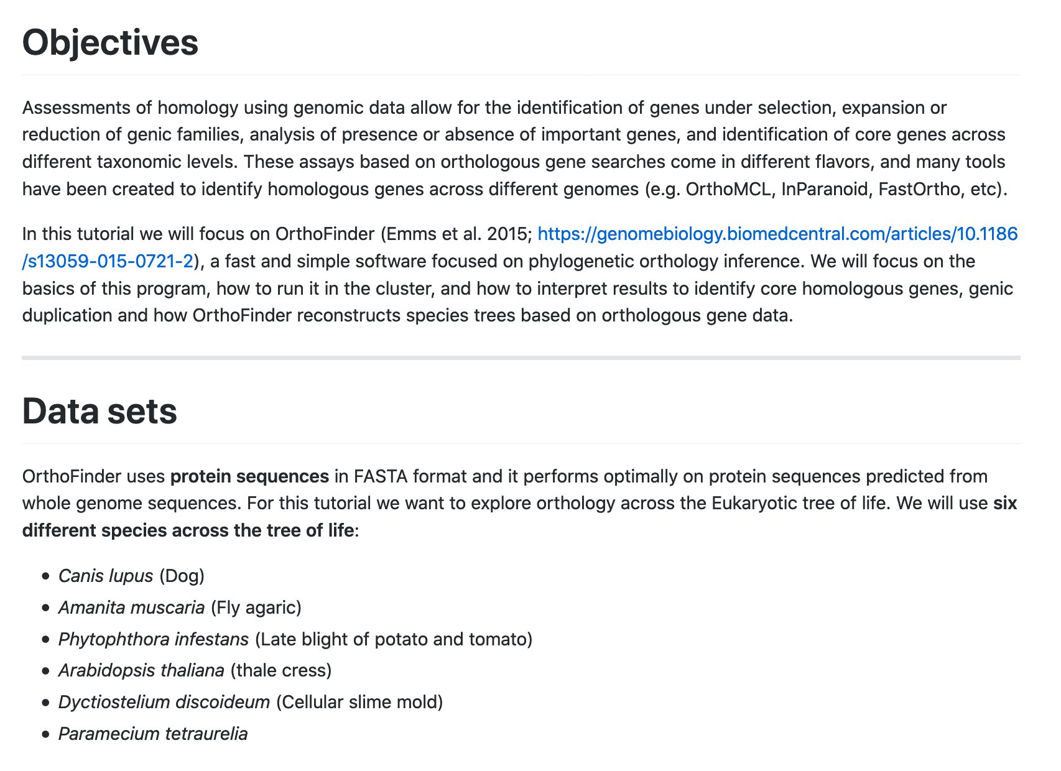
OrthoFinder 2

Slide 24
OrthoFinder 2
https://qrgo.page.link/pnRYK

